Slide 1
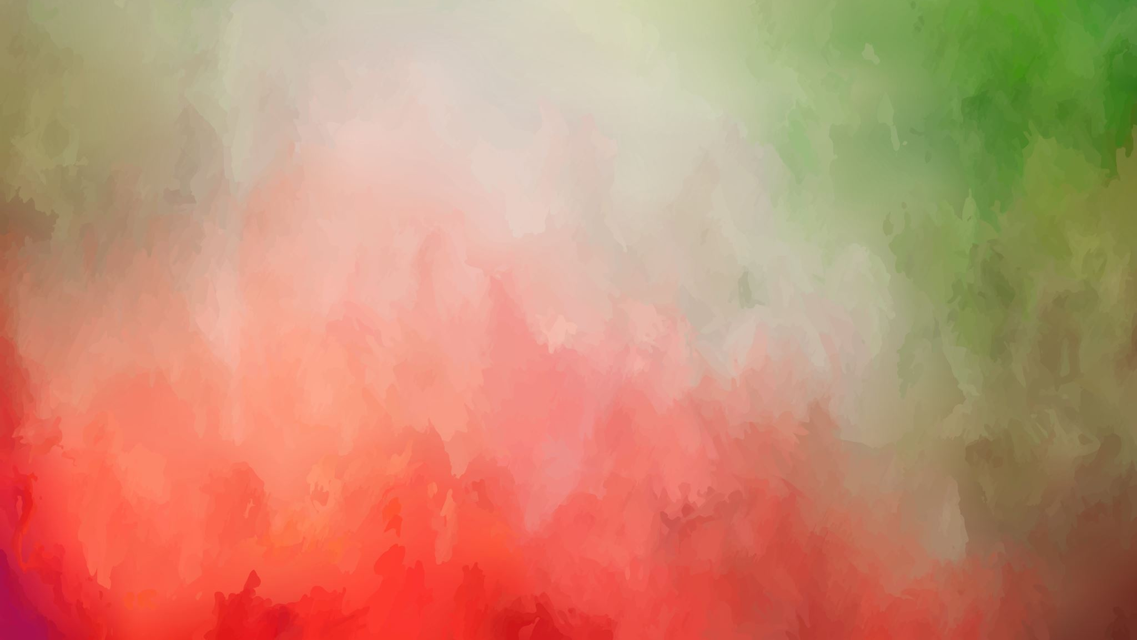
Neural Style Transfer
Sai Lokesh Gorantla
20IE10028

Slide 2
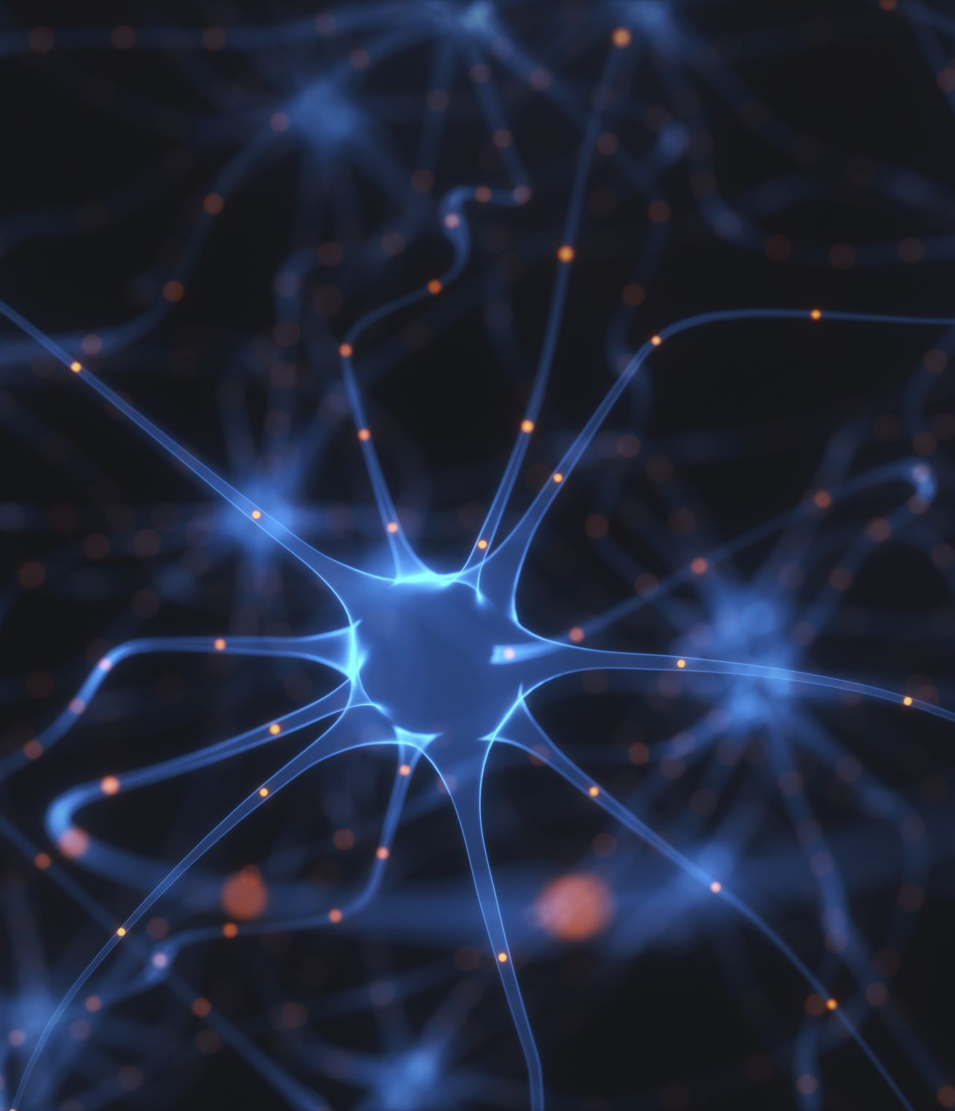
Introduction
Neural Style Transfer is one of the beauties of Neural Networks which lets us to apply the style used in a painting to another picture
Helps in creating artificial artworks from paintings
Data augmentation is a critical use-case*
Entertainment and social communication*
* Explained in the later slides

Slide 3
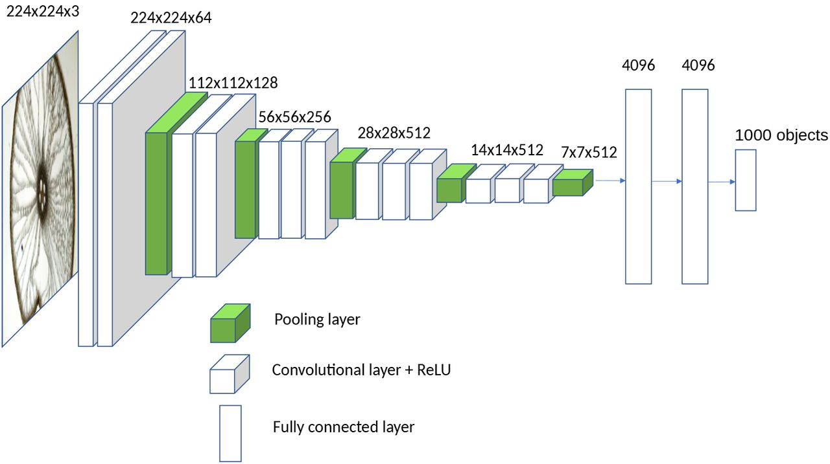
The VGG 19 Architecture

Slide 4
Cost function and optimization
J = α * J(C,G) + β * J(S,G)
J_{content} = J(C,G) = ΣΣΣ(a_{ijk}^{(C)} – a_{ijk}^{(G)})²
'a' represents the activation
J_{style} = J(S,G) = (1/(2*n_{H}*n_{W}*n_{C})) * ΣΣ(G_{ab}^{(S)} - G_{ab}^{(G)})²
G_{ab}^{(S)} = ΣΣ a_{ij}^{(S)}*a_{ij}^{(S)} — Gram matrix of Style Image
G_{ab}^{(G)} = ΣΣ a_{ij}^{(G)}*a_{ij}^{(G)} — Gram matrix of Generated Image
Apply gradient descent over the generated image: dJ/dG
[Gatys et al., 2015. A neural algorithm of artistic style]

Slide 5
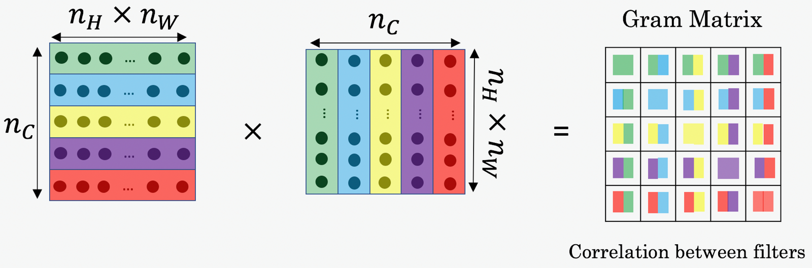
Gram Matrix
The gram matrix is a square matrix that contains a dot product of each vectorized filter in layer 'l'
It compares how similar the tensors are. If they are highly similar, we get a higher resultant value
We can understand Gram matrix as a mathematical entity used to compare style and generated images

Slide 6
How to generate the image
Initiate the generated image with random values
Pick a layer (preferably middle) from the VGG model to find the activations
Calculate content and style costs
Tune the parameters α and β to obtain required results
Run the gradient descent over Generated image, unlike on the weights as in a NN G = G - α * dJ(G)/dG
Try choosing a different layer and repeat these steps until we get a satisfactory result

Slide 7
More about the algorithm
The paper "Visualizing and Understanding Convolutional Networks" explains how Convolutional Networks work
The neurons of shallow layers are triggered by smaller image patches, and the deeper neurons are triggered for larger image patches, say a part of a car or flower
Extending this, as described in the paper "A Neural Algorithm of Artistic Style", we can choose a set of layers to calculate the J_{style}
This gives a better result as here we consider shallow and deeper layers, giving them weights to find the style loss
[Gatys et al., 2015. A neural algorithm of artistic style and Zeiler and Fergus., 2013, Visualizing and understanding convolutional networks]

Slide 8
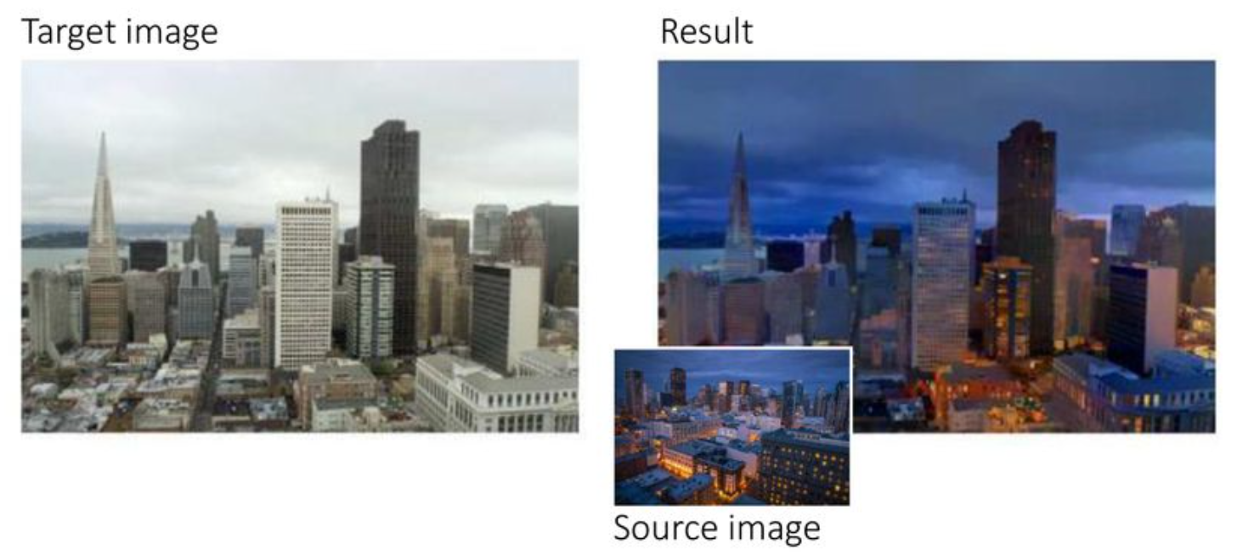

Slide 9
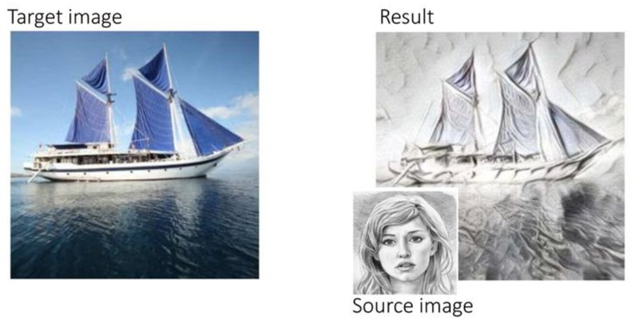

Slide 10
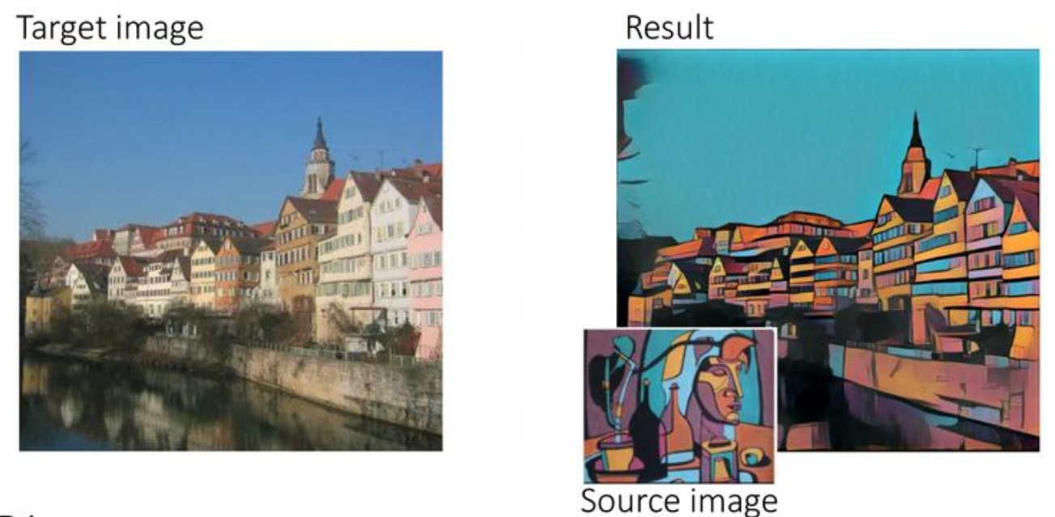

Slide 11
